Slide 1

Box Score to Bracket: Evaluating the Predictive Power of NBA Regular Season
Performance on Playoff Outcomes
Andrew Scheiner ’25, Sid Lamsal ’25, Department of Data Analytics, Dickinson College
Introduction
This project explores how accurately NBA regular season data can predict playoff outcomes using neural networks trained on game-by-game statistics. The goal is to identify patterns in predictive accuracy as the season progresses, uncovering whether certain segments of games better indicate postseason success. By addressing doubts about the regular season’s value, this study offers potential insights to enhance sports analytics, inform league policies, and showcase the dynamic applications of machine learning in real-world scenarios.
Results
Highlight your LARGE photographs, charts, maps, or in this central arena.
Don’t include every graphic you’ve made that relates to project. Choose one. Or two. And separate graphics with plenty of white space.
Annotate graphics with arrows and callout boxes so that viewer is visually led through how hypothesis is addressed. The goal is to enable viewers to understand the logic behind your conclusions without you needing to be there.
Keep font size of all text (even graph labels) as big or bigger than in rest of poster.
Findings
Explain why outcome is interesting. Don’t assume it’s obvious. Three sentences max
If you have just one or two simple graphics, viewers will be drawn to explore them. If you have too many or they are too complicated, visitors will be repelled.
Implications
[]
Data Processing
Four sentences max.
If viewer truly wants to know gruesome details, they’ll ask or email you.
Sometimes adding a pic is good.
Next Steps
[]
Data Sources
NBA.com’s official stats website
Used the stats.nba.com API to scrape traditional and advanced box score data

Slide 2
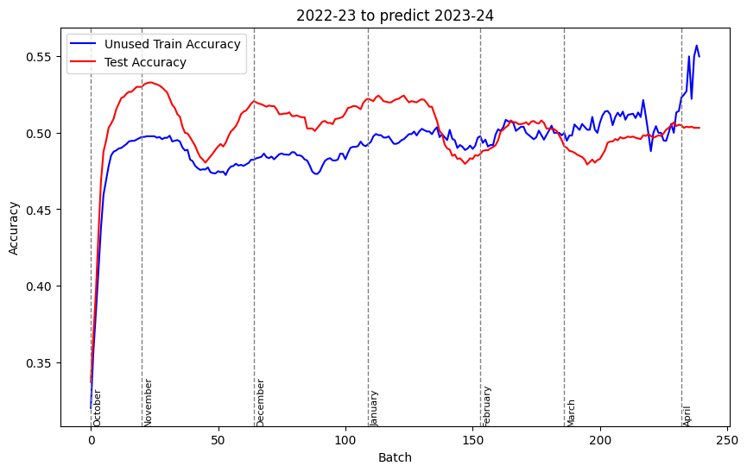
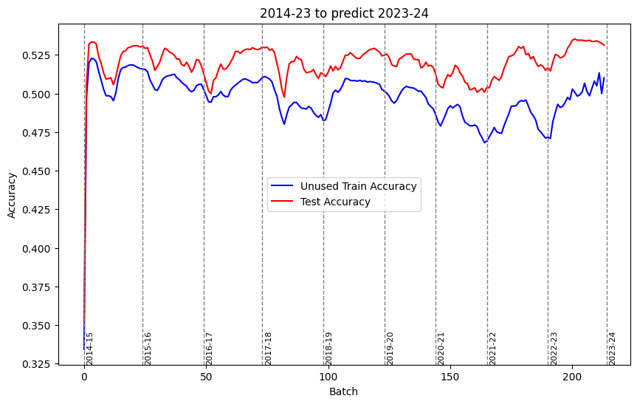
Box Score to Bracket: Evaluating the Predictive Power of NBA Regular Season
Performance on Playoff Outcomes
Andrew Scheiner ’25, Sid Lamsal ’25, Department of Data Analytics, Dickinson College
Introduction
This project explores how accurately NBA regular season data can predict playoff outcomes using neural networks trained on game-by-game statistics. The goal is to identify patterns in predictive accuracy as the season progresses, uncovering whether certain segments of games better indicate postseason success. By addressing doubts about the regular season’s value, this study offers potential insights to enhance sports analytics, inform league policies, and showcase the dynamic applications of machine learning in real-world scenarios.
Results
Findings
Our neural network predicted NBA playoff outcomes with an average accuracy of 50%, peaking at 55%.
Game-by-game training enhances predictive accuracy, following a semi-logarithmic trend.
Predictive performance improves sharply at first, then plateaus, with accuracy declining slowly after the initial surge.
Implications
Our model could tell early on what level of performance correlated to a particular playoff finish, but it was not entirely accurate.
Our predictive margin of error was around +/- 3 games of playoff result – which is the difference between losing or advancing to the next round
Rolling average performance over stretches of games will affect prediction ability
Data Processing
We first scraped and collected our data using the requests library in Python (see data sources section).
Using the pandas library in Python, we were able to process scraped box score data for each NBA team (using global and team identifiers) and merge it together by season.
Visuals were created using seaborn and matplotlib.
Neural network was created using the keras library in Python.
Next Steps
Creating specialized models for each team.
Experimenting with different model types other than neural networks, hoping to find more accurate models for predicting.
Data Sources
NBA.com’s official stats website
Used the stats.nba.com API to scrape traditional and advanced box score data

